Slide 1

<Cyber Glove>
School of Computer Science and Engineering
Department of Computer Science and Engineering
Submitted By:
<Bhanu Agrawal>
<23FE10CSE00083
Supervised By:
<Amit Kumar Gupta>

Slide 2
Outline
Introduction
Literature Review
Problem Statement
Proposed Solution
Objectives
Results

Slide 3
Problem Statement
Traditional input devices and vision-based gesture systems are costly, contact-dependent, and inefficient in dynamic environments. There is a need for a low-cost, touchless, and real-time gesture recognition system that enables natural human–computer interaction using minimal hardware and intelligent processing.
Traditional human–computer interaction methods rely heavily on physical input devices such as keyboards, mice, and touchscreens, which limit flexibility, mobility, and accessibility. Existing gesture recognition systems, while offering touchless control, often depend on expensive cameras or multiple sensors, making them complex, power-intensive, and unsuitable for real-time embedded applications . The DataGlove project aims to address these limitations by developing a low-cost, intelligent wearable glove that uses MPU6050 motion sensing and Hall-effect sensors for hybrid gesture detection. By applying an LSTM-based AI model, the system can accurately classify hand gestures and enable touchless, real-time interaction for applications such as virtual keyboards, assistive technologies, and IoT control systems.

Slide 4
Application of AI approaches
1. AR/VR Control
2. Keyless Keyboard
3. Assistive Technology for Disabled people
4. IoT & Smart Device Control
5. Human–Robot Interaction
6. Gaming and Creative Interfaces

Slide 5
Objectives
The CyberGlove system follows a hybrid sensing and AI-driven methodology. It integrates motion sensing (IMU) and magnetic sensing (Hall-effect) for data acquisition, which is then processed and analyzed through a Long Short-Term Memory (LSTM) model. The workflow includes:
Data acquisition using sensors on a glove.
Data preprocessing and normalization.
Model training using time-series data.
Real-time testing and validation on an ESP32 microcontroller.
This systematic approach ensures accurate, low-latency gesture recognition.

Slide 6
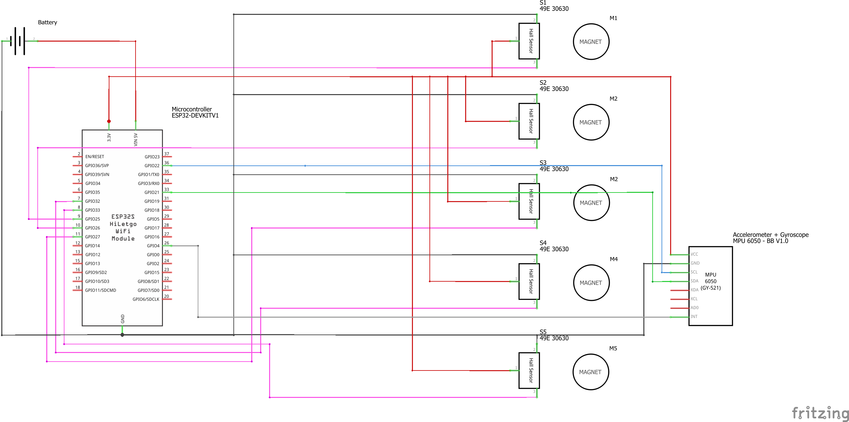
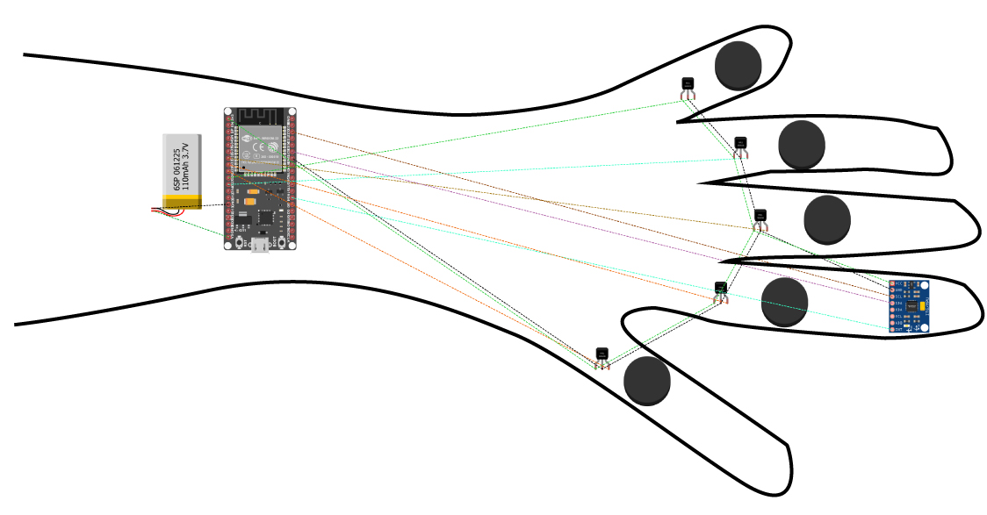
Circuit Dagram
. Circuit diagram of the DataGlove system showing sensor fusion and communication flow.
Visual representation of the DataGlove system

Slide 7
Outcome
Patent (Published)
Research Paper (2~3)
  Data Set Aquasition and Hardware Tuning
  Data pre processing techniques
  Comparitive study using different techniques

Slide 8
References
1. Ferraris, F., Grimaldi, U., & Parvis, M. (1995).
“Procedure for effortless in-field calibration of three-axis rate gyros and accelerometers.” IEEE Transactions on Instrumentation and Measurement.
https://ieeexplore.ieee.org/document/387598
2. Tedaldi, D., Pretto, A., & Menegatti, E. (2014).
“A Robust and Easy to Implement Method for IMU Calibration.” IEEE ICRA 2014.
https://arxiv.org/abs/1405.6712
3. Diebel, J. (2006).
“Representing Attitude: Euler Angles, Unit Quaternions, and Rotation Vectors.”
https://citeseerx.ist.psu.edu/document?repid=rep1&type=pdf&doi=5e1f1b9c5e0cfeef5b1b68e5e2e8f5c03d8d5b0f
4. Sabatini, A. M. (2006).
“Quaternion-based Extended Kalman Filter for determining orientation by inertial and magnetic sensing.” IEEE Transactions on Biomedical Engineering.
https://ieeexplore.ieee.org/document/1642586
5. Madgwick, S. O. H. (2010).
“An efficient orientation filter for inertial and inertial/magnetic sensor arrays.”
https://x-io.co.uk/res/doc/madgwick_internal_report.pdf
6. Hochreiter, S., & Schmidhuber, J. (1997).
“Long Short-Term Memory.” Neural Computation.
https://www.bioinf.jku.at/publications/older/2604.pdf
7. Ordóñez, F. J., & Roggen, D. (2016).
“Deep Convolutional and LSTM Recurrent Neural Networks for Multimodal Wearable Activity Recognition.”
https://arxiv.org/abs/1604.08880

Slide 9
Thank You

